Slide 1
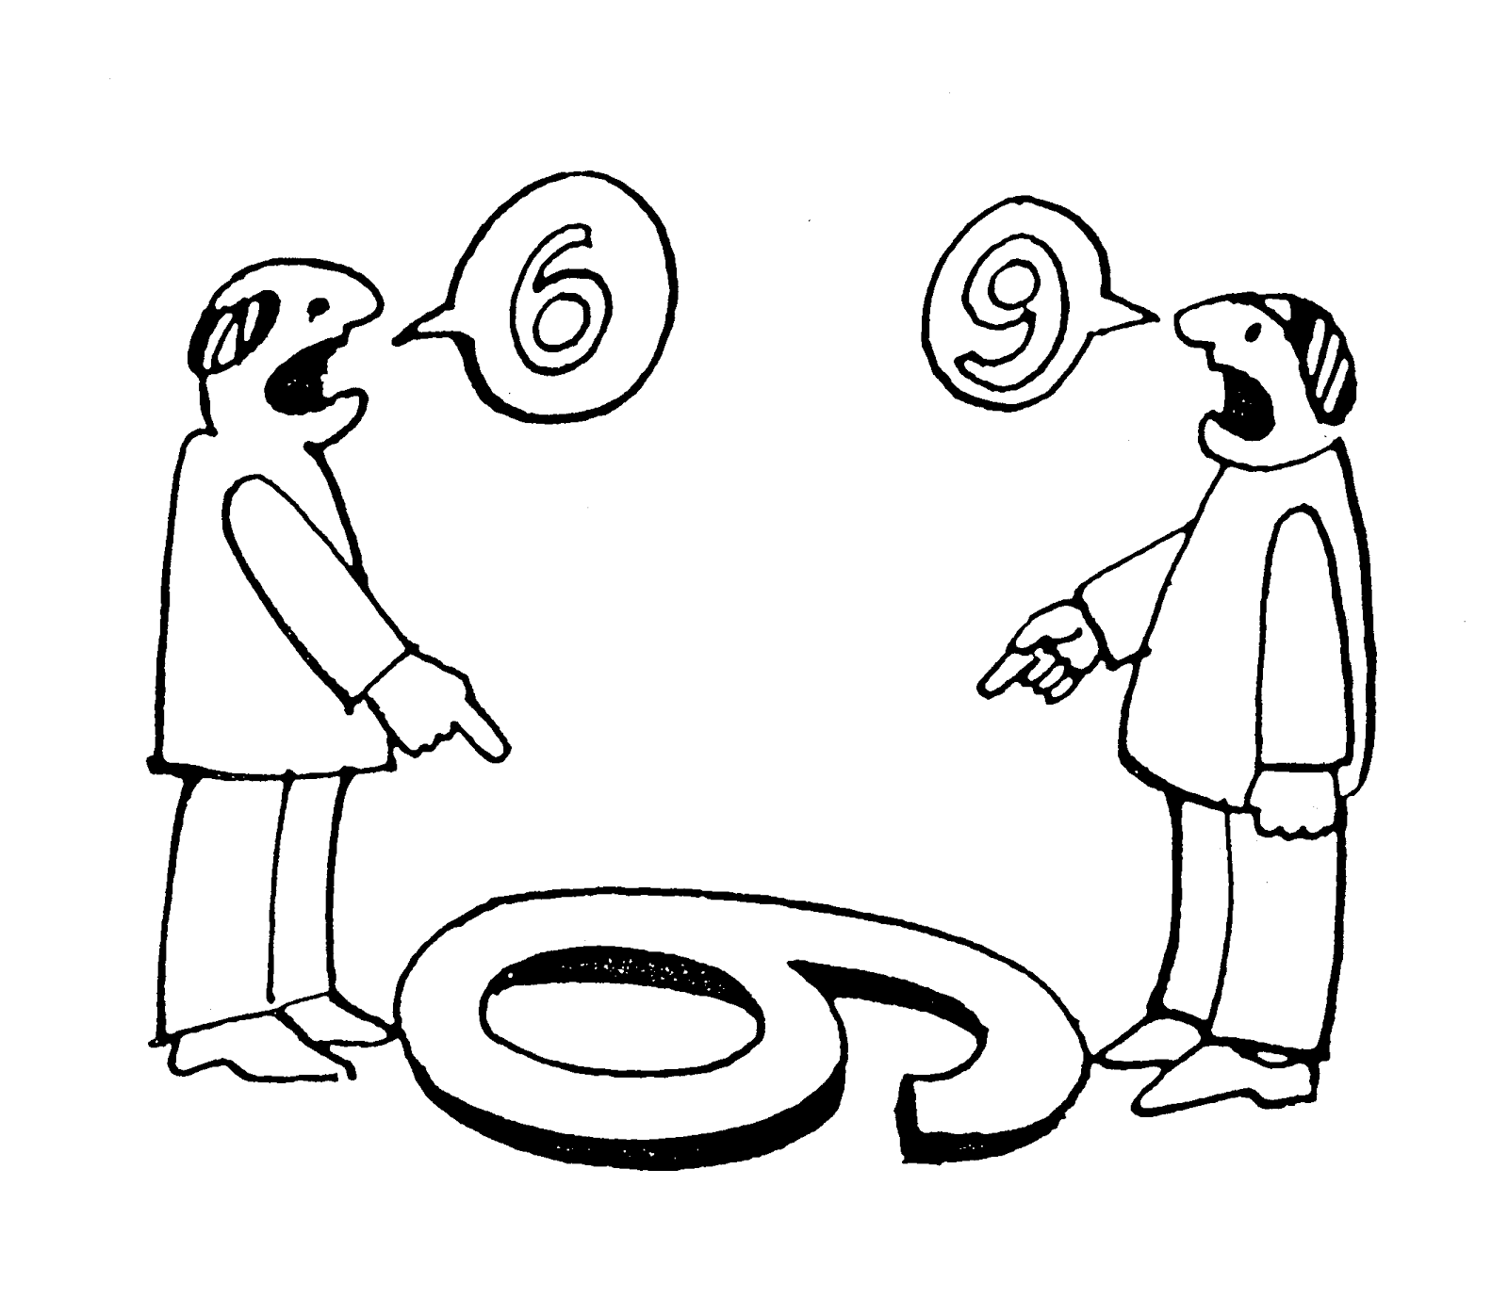
Incorporating Debates and Multiple Perspectives in History Lessons
Diane Haleas
Saint Ignatius College Prep
Chicago
diane.haleas@ignatius.org

Slide 2
History’s Habits of Mind
“Perceive past events and issues as they might have been experienced by the people of the time, with historical empathy rather than present-mindedness.”
“Appreciate the diversity of cultures and variety of historical contexts, as well as to distinguish elements of our shared humanity.”

Slide 3
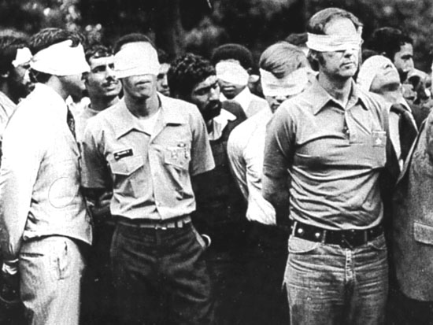
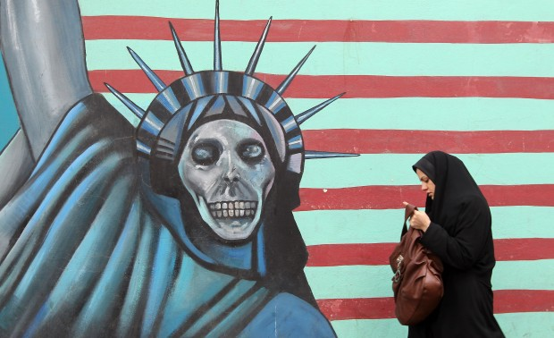
United States-Iran Relations since WW II
Objectives: Students will research the different perspectives of Iran and the United States and discuss and debate specific events such as the 1953 coup, the Islamic Revolution 1979, and the Iran Nuclear Deal 2016

Slide 4
Lesson Activities (You can substitute any two sides from any number of issues/events. For example: The United States and Soviet Union perspectives of Cold War events)
PREPARATION
Divide the class in half. One-half will research and represent the Iranian perspective of U.S.-Iranian relations. The other half will research and represent the American perspective.
Students are instructed (via written and oral directions)
to research events involving the U.S. and Iran since WW II
to cover the events in chronological order
to determine why their assigned side might feel suspicious, angry, or mistrustful of the other side based on these events

Slide 5
In-Class Activity
Divide the class in half, facing each other.
Give each student a handout that has two columns (1. U.S. Perspective, 2. Iranian Perspective)
Go in chronological order with points.
Have a student(s) from one side raise a point about an event. Have the student(s) explain the event and their side’s perspective/feelings/beliefs about the event.
Students should stand to deliver their points.
Write down notes on the board to help students process the information and to write them on their handouts.
Ask students from the other side to respond to the point raised by the other side.
Continue going back and forth having each side explain events, offer their perspective, and ask the other side to respond.

Slide 6
Next class or homework assignment
Using their notes from class and their research, each student will imagine that he/she is a current teenager from the U.S. or Iran (same side as previous activity) and write a letter to a teenager from the opposing side. The letter should explain how they view U.S.-Iran relations and why they have these beliefs and feelings.
Students should write responses to the letters they receive.

Slide 7
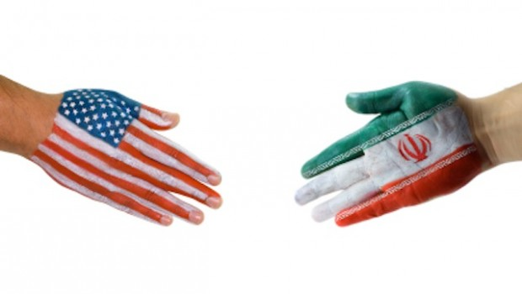
Debrief Activity
Reflection Questions
In what ways is Iran justified in its current perspective of the United States?
In what way is the United States justified in its current perspective of Iran?
What could be done to help improve U.S.-Iranian relations today?

Slide 8
Open Forums
Students are assigned to represent a specific person or member of a specific group. They share their person’s/group’s perspective on an issue/event.
Meeting with Chinese Citizens and CCP Politburo
Industrialization Period: workers, industrialists, managers, farmers, women..
Revolutions: Bring together different sectors of society.
Debates with Judges
Assign a small group of students to serve as judges for the debate. They prepare rubrics in advance.
Confucianism/Daoism/Legalism as best ideology for Chinese Dynasties
Perspectives on the Opium Trade (Britain vs. China)

Slide 9
Debates with Student Reflections
After a debate or a round of a debate, students in the audience write a response to the arguments provided, perhaps choosing a side and explaining the reasoning behind their choice.
Capitalism vs. Socialism vs. Utilitarianism vs. Communism
Columbian Exchange vs. Imperialism: Impact of the world today
Power of political institutions in a given country
Debates as a Bracket Challenge
Students compete in bracket rounds to get to a champion!
Ancient Greek Philosophers: Most important contributions
Causes of World War I: Most significant
Innovations of Industrial Revolution: Greatest impact

Slide 10
Social Gatherings
Students role-play an individual and engage in informal conversations with each other in a social setting (food and drink involved).
House of Wisdom
Enlightenment Salon
Founding Fathers
Any historical figures
Negotiations
Students represent different groups embroiled in conflict and attempt to resolve the problem.
Indian Nationalism
South China Sea
Crusades
Israel-Palestine

Slide 11
What if? Roundtables
Students respond in writing to a “what if” prompt and then take turns sharing their responses. Other students may comment or ask questions.
What if Napoleon never became Emperor?
What if the Germans won WW II?
Role-Playing Simulations
Students revisit an important historical event by role-playing the different groups or individuals involved. Do students behave similarly or differently from the historical event? Is the outcome similar or different?
Congress of Vienna
Paris Peace Conference
Berlin Conference
Yalta Conference

Slide 12
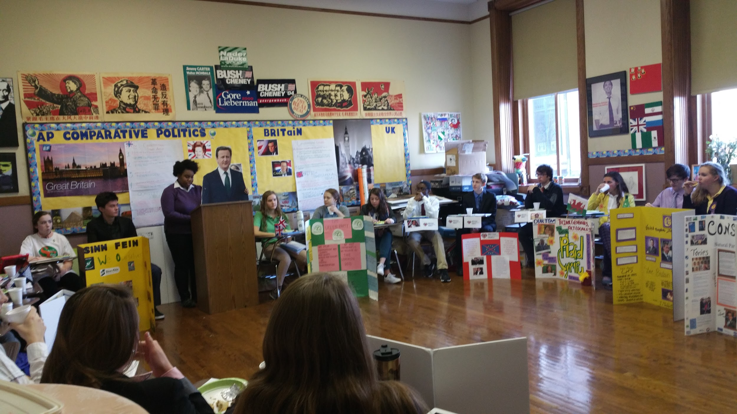

Slide 13
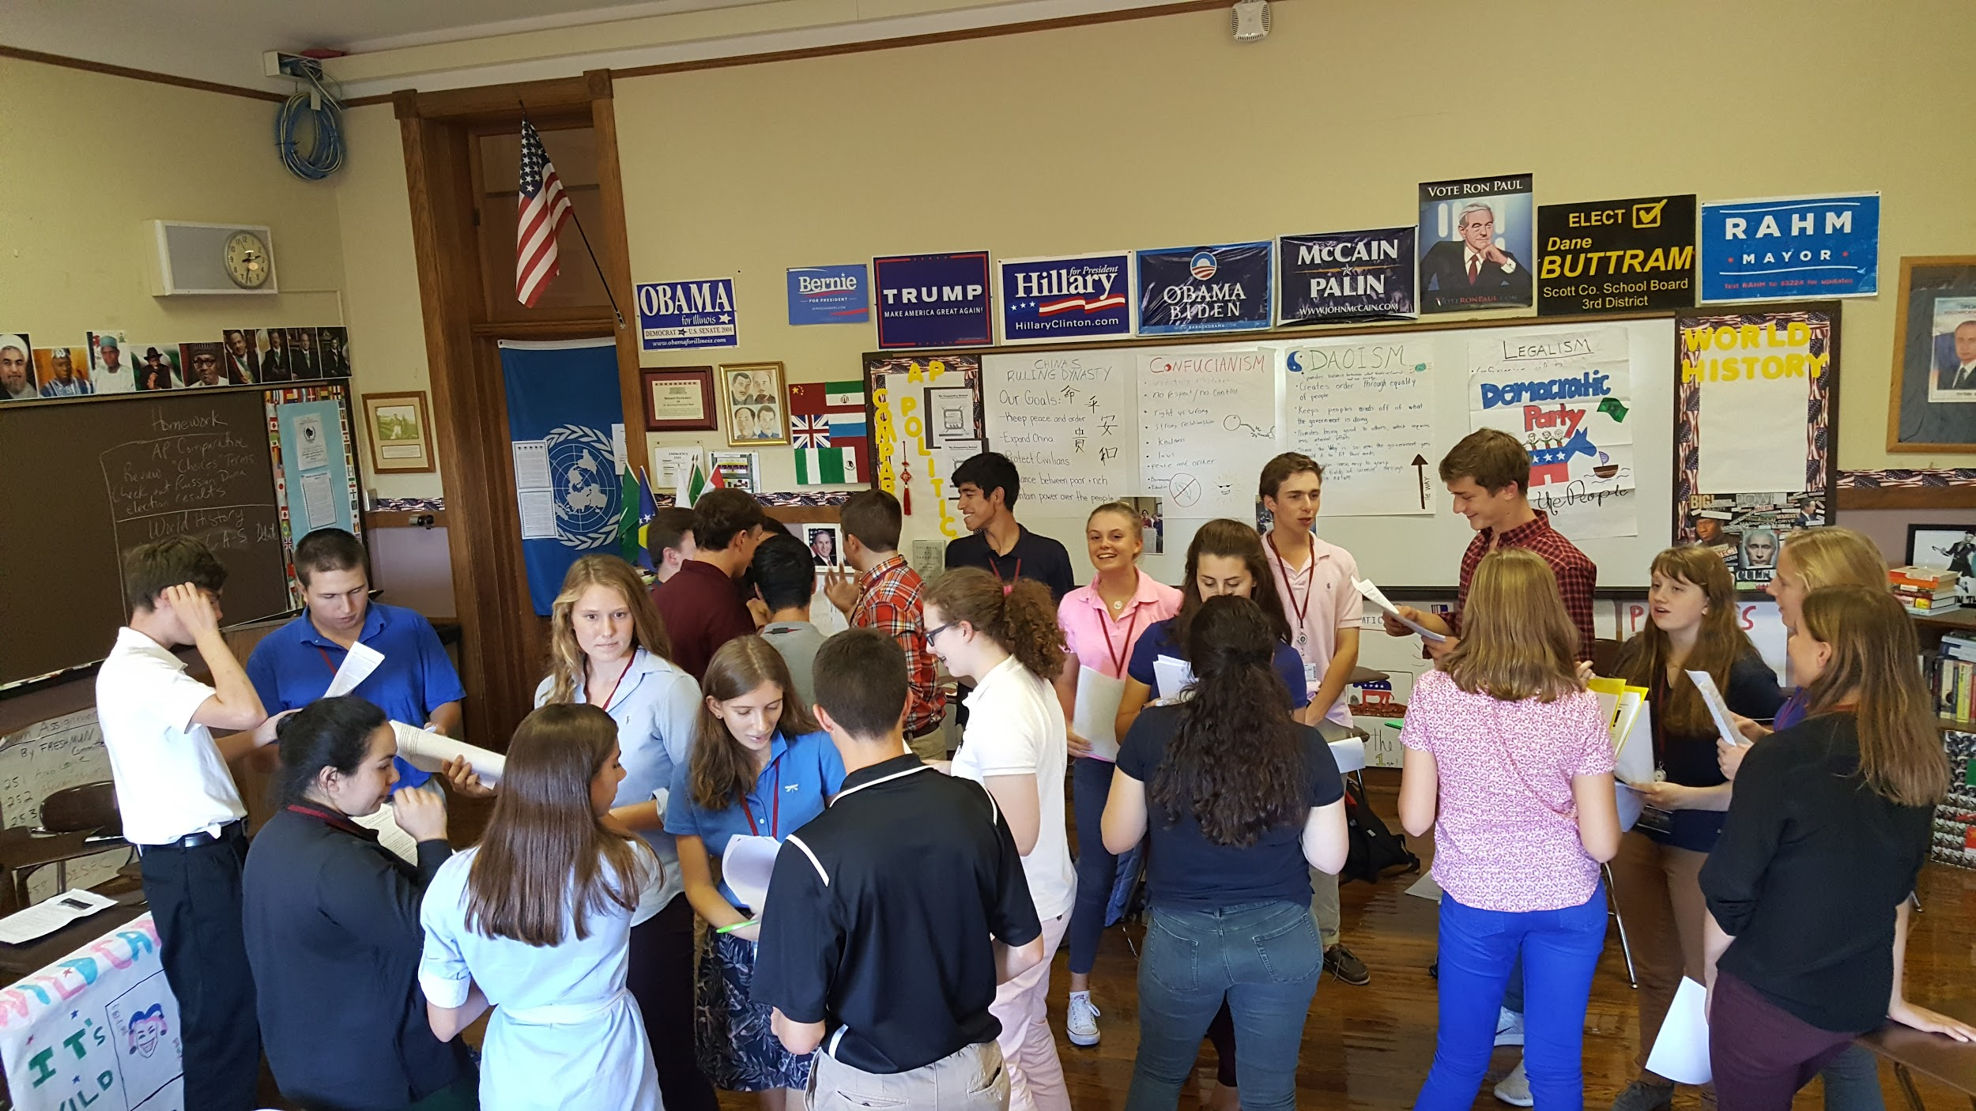

Slide 14
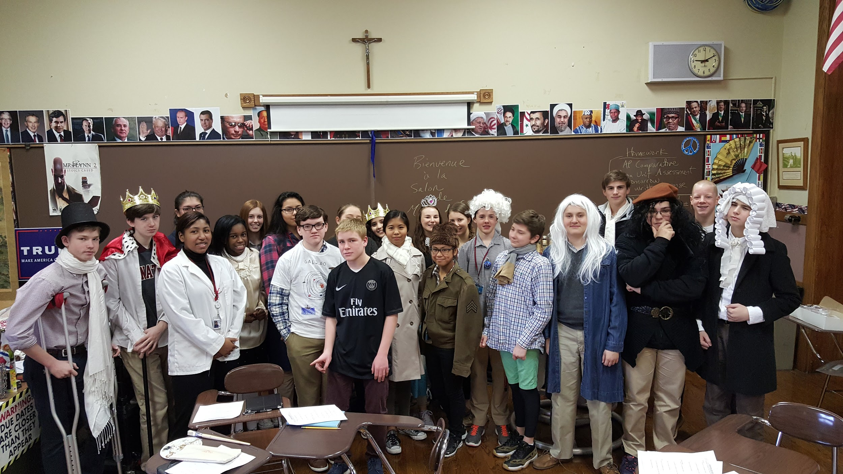

Slide 15
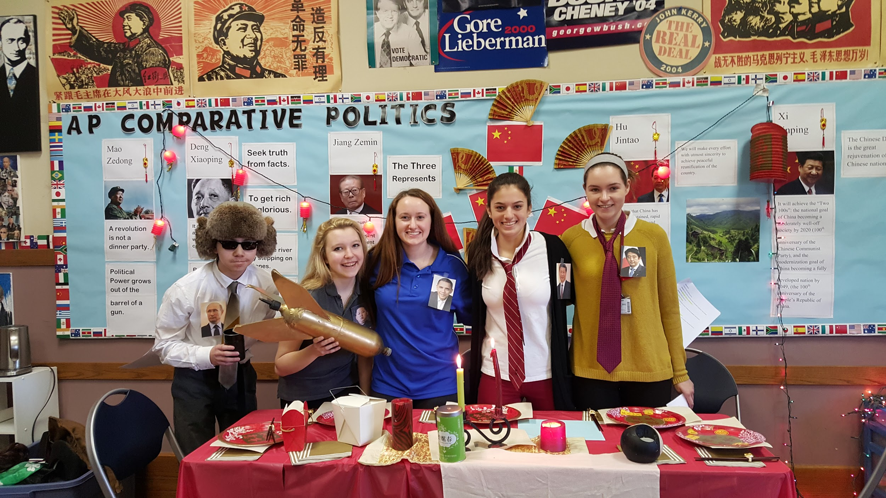

Slide 16
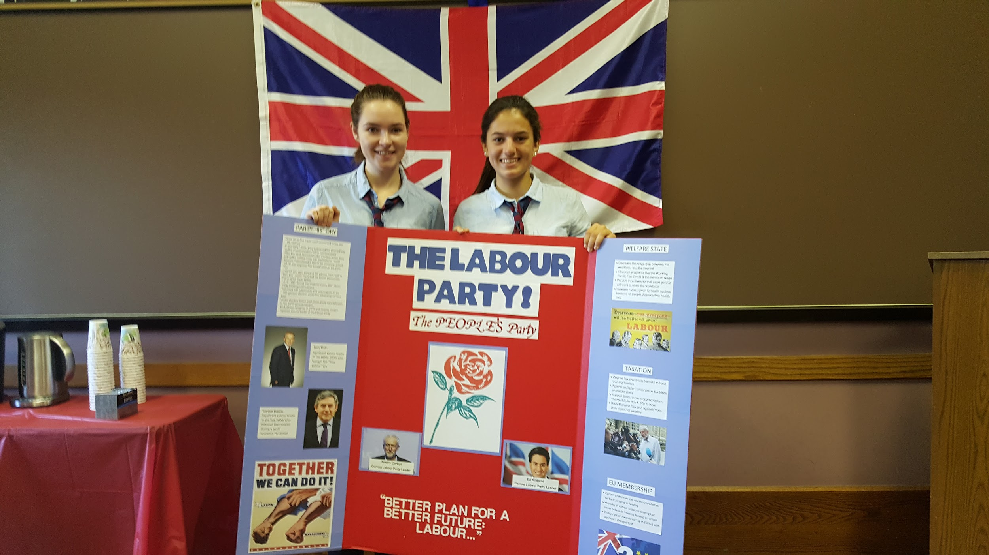

Slide 17
Please Contact Me
diane.haleas@ignatius.org

