Slide 1
The following presentation was made by Henry Sweets, Executive Director of the Mark Twain Boyhood Home & Museum, Hannibal, Missouri, at the Missouri Council for History Education meeting in Hannibal, Missouri, September 29, 2016. This has been provided to the Council for inclusion on its web site. Permission is granted for classroom use and general background. Permission must be obtained from the Mark Twain Boyhood Home & Museum for any further publication or use of this program or use of images in the accompanying power point presentation. Mark Twain Boyhood Home & Museum 120 North Main Street Hannibal MO 63401

Slide 2
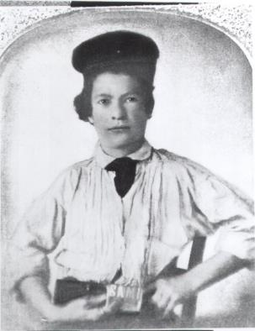
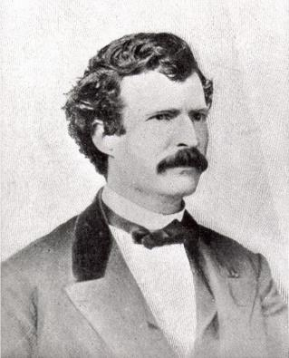
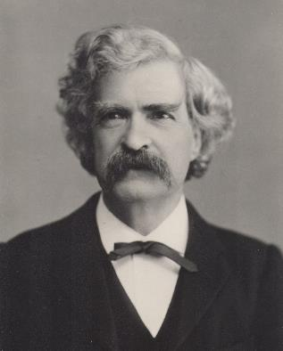
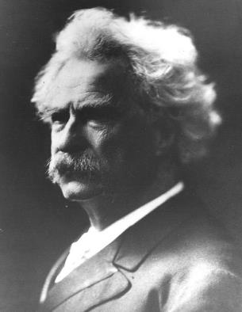
MARK TWAIN: Right Place at the Right Time in American History Henry Sweets Mark Twain Museum

Slide 3
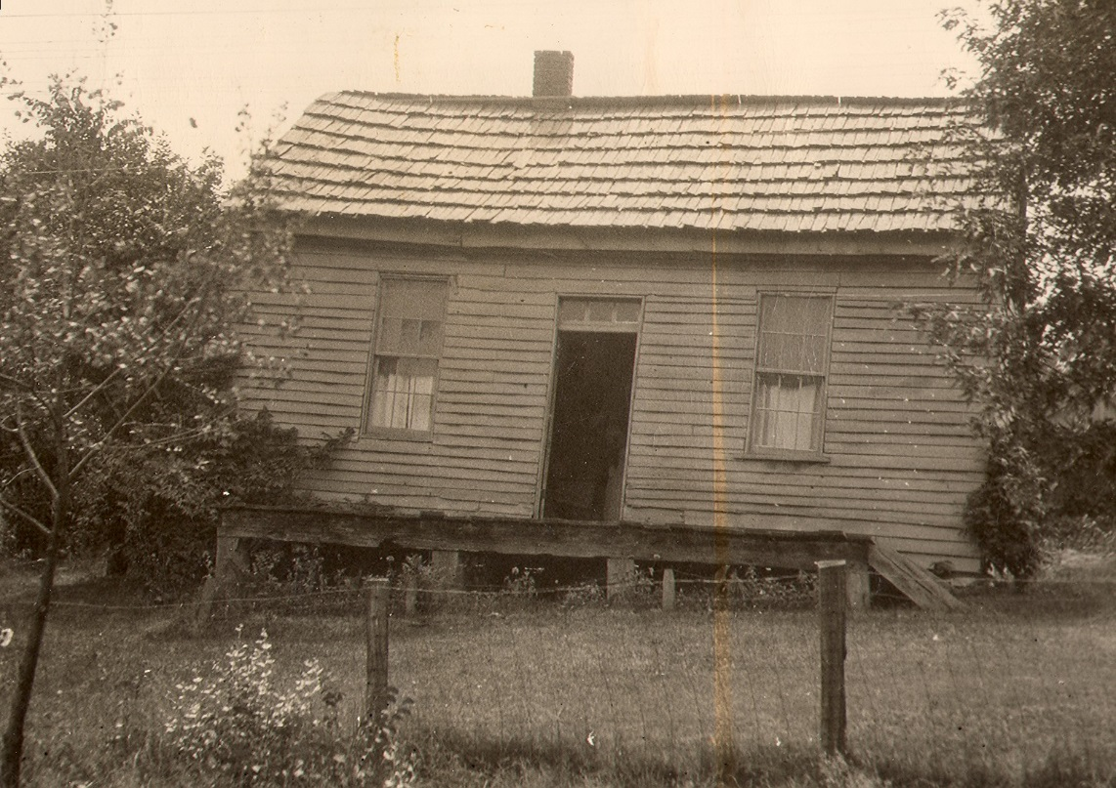

Slide 4
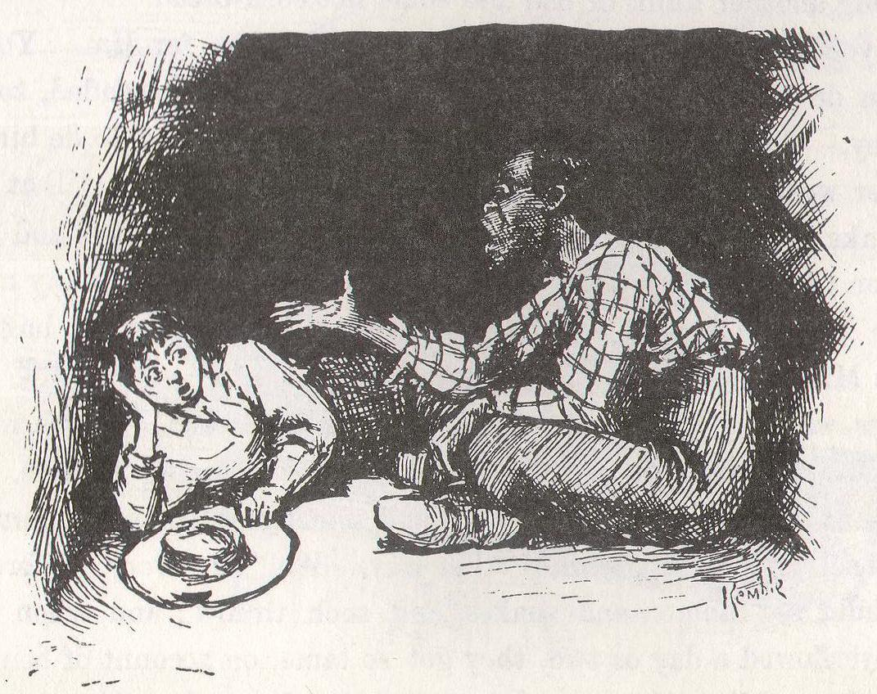

Slide 5
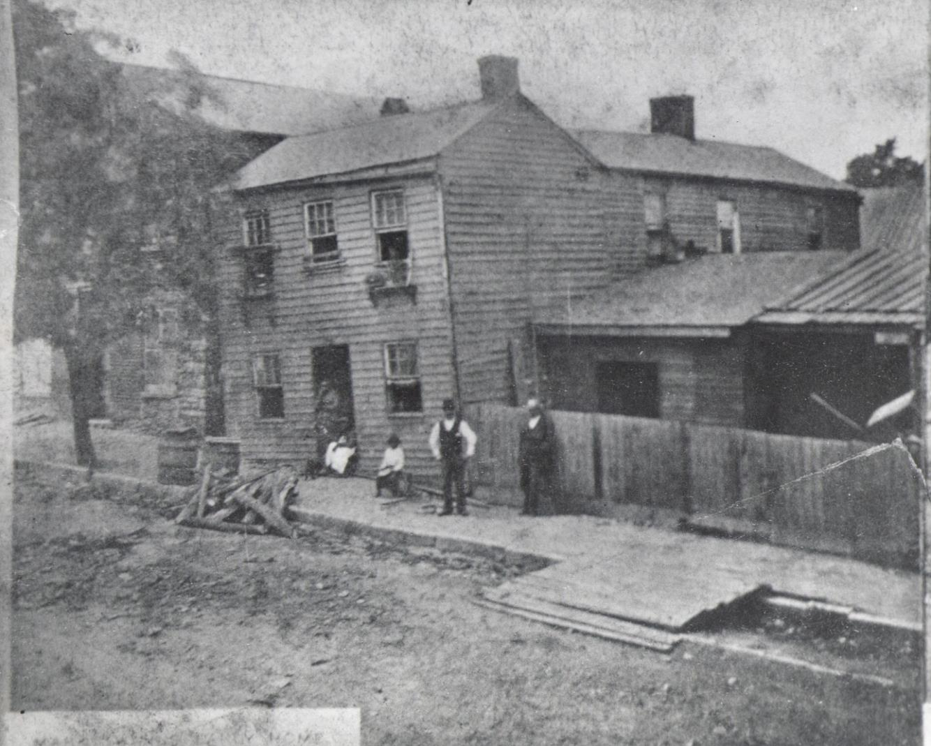

Slide 6
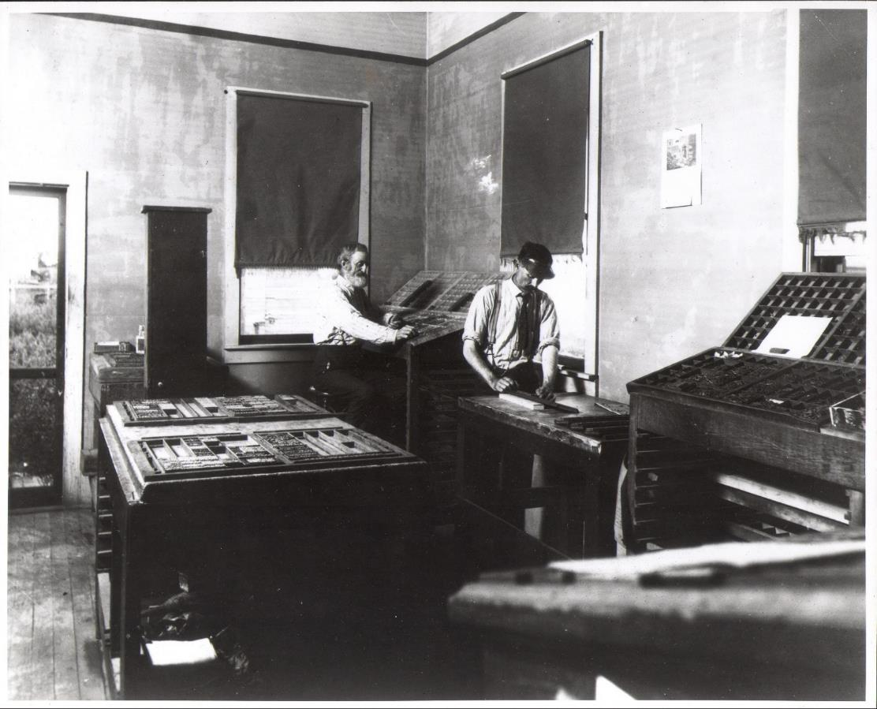
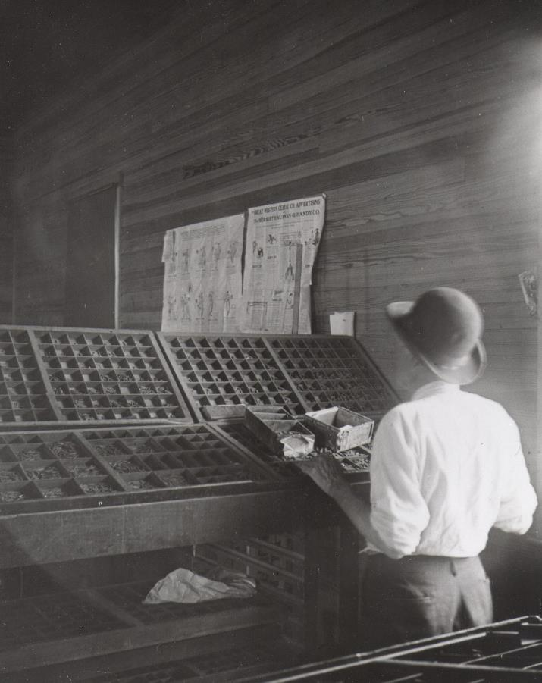

Slide 7
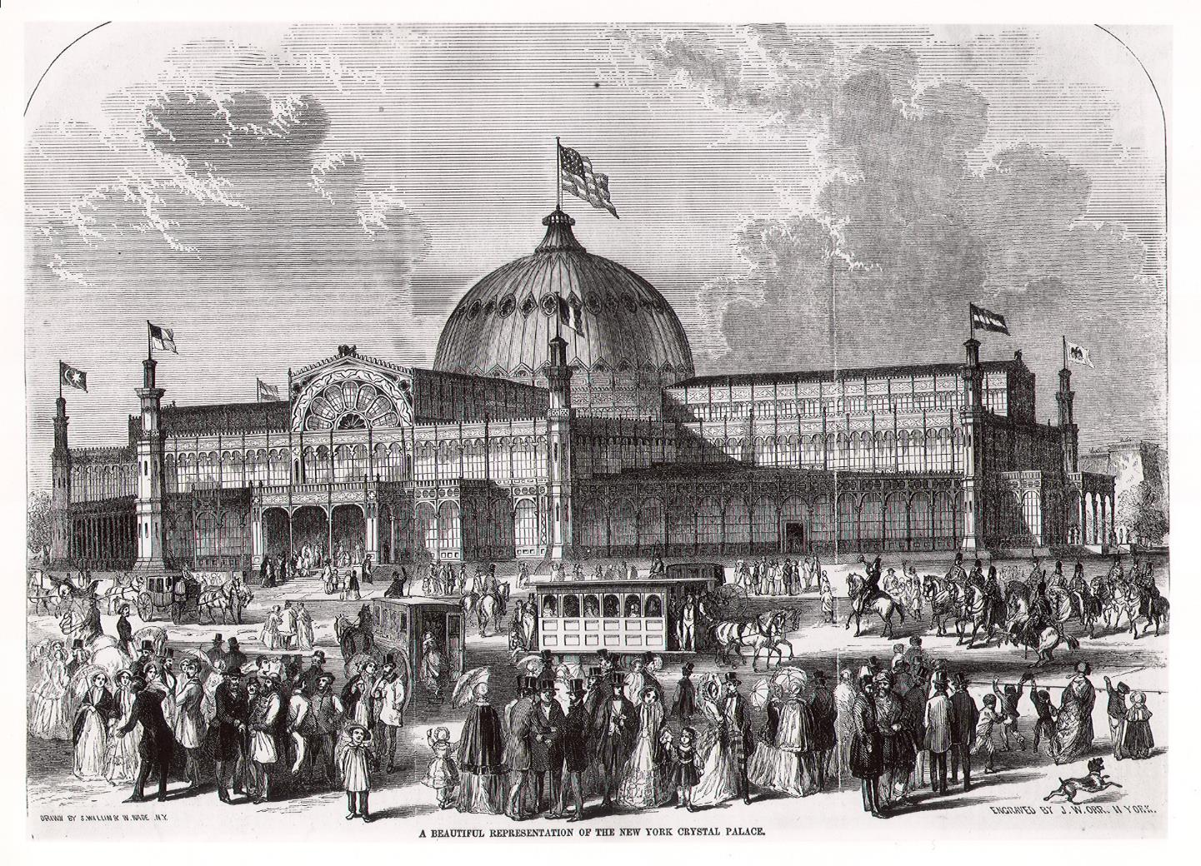

Slide 8
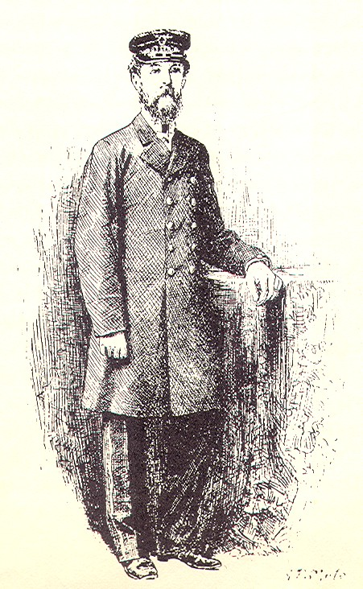
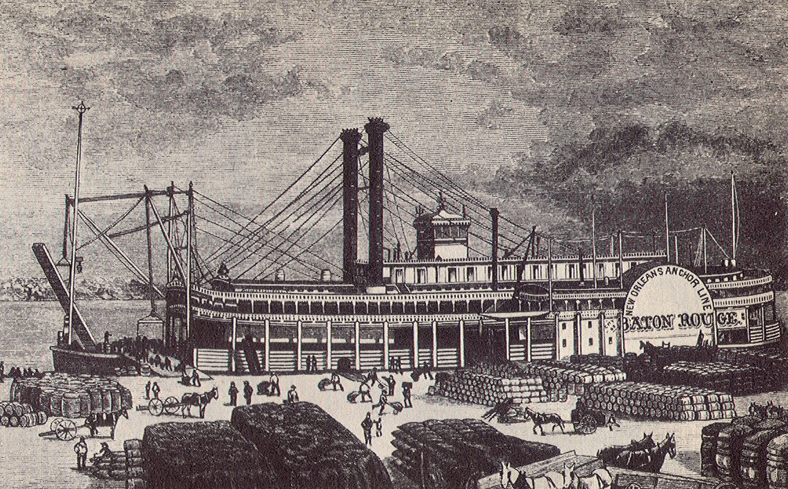

Slide 9
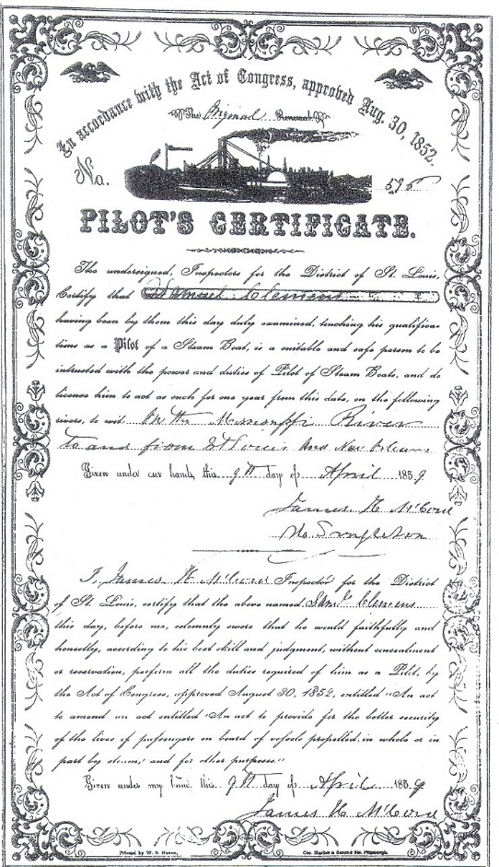
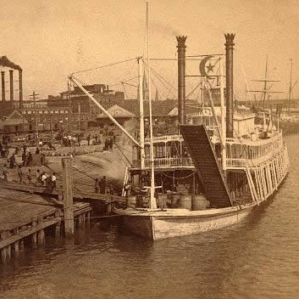

Slide 10
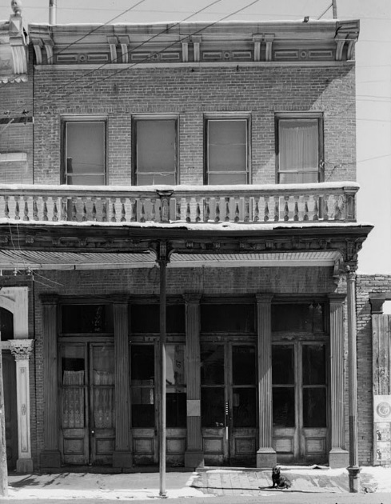
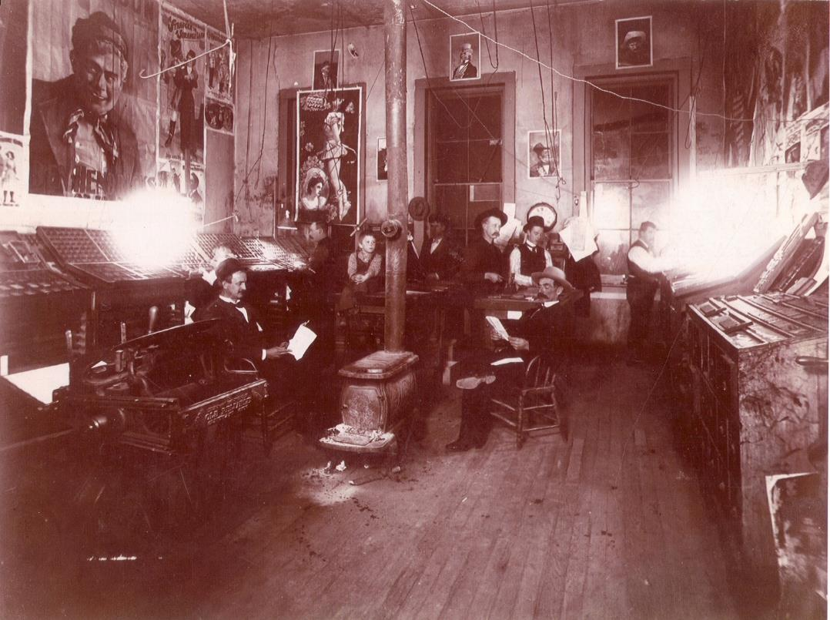

Slide 11
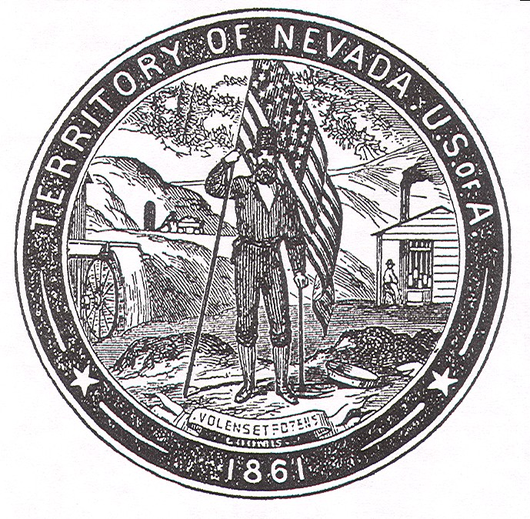
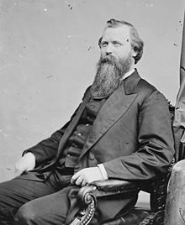

Slide 12
Pen Names Sam Clemens Used W. Epaminondas Adrastus Blab Rambler Josh Thomas Jefferson Snodgrass Sergeant Fathom MARK TWAIN

Slide 13
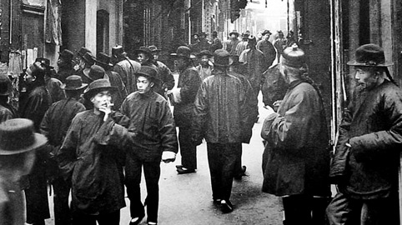
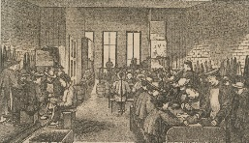

Slide 15
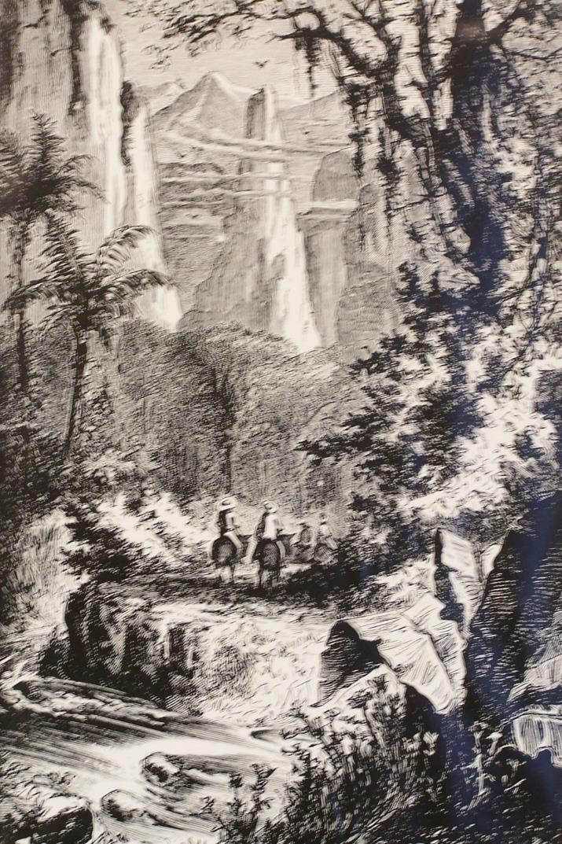
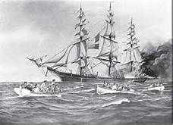

Slide 16
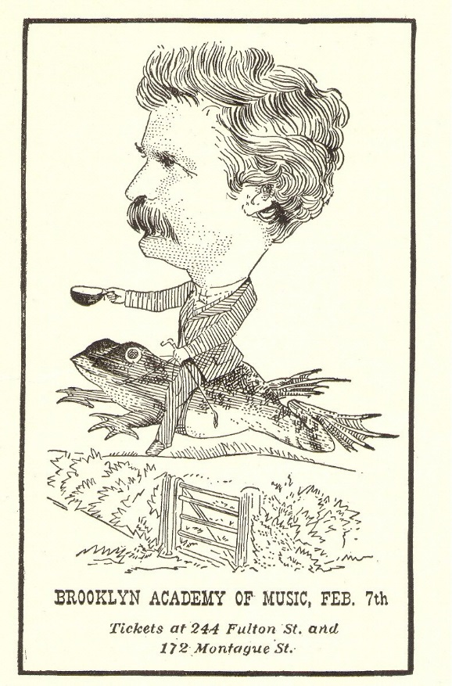
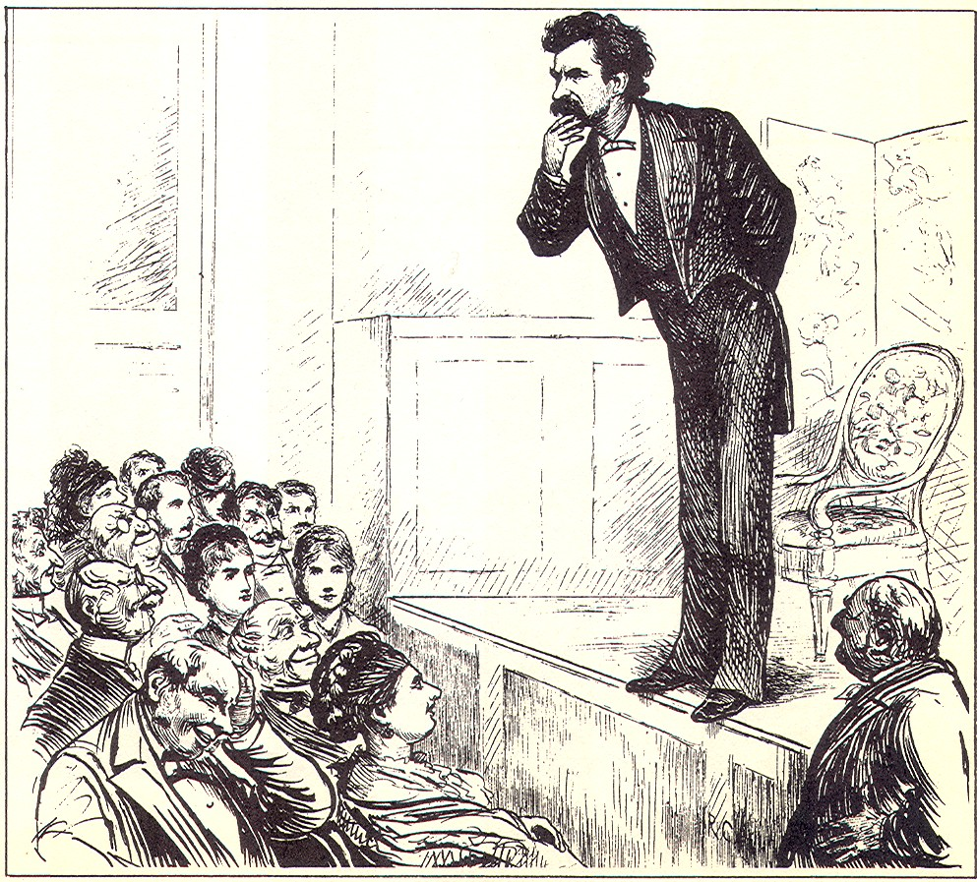

Slide 17
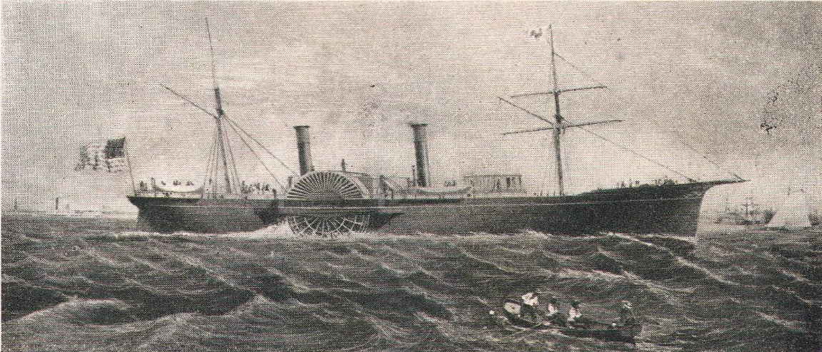

Slide 18
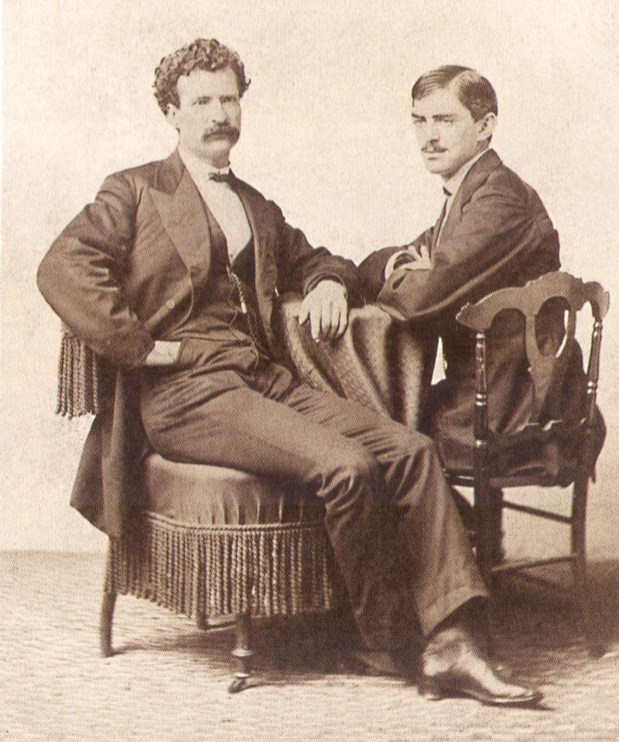
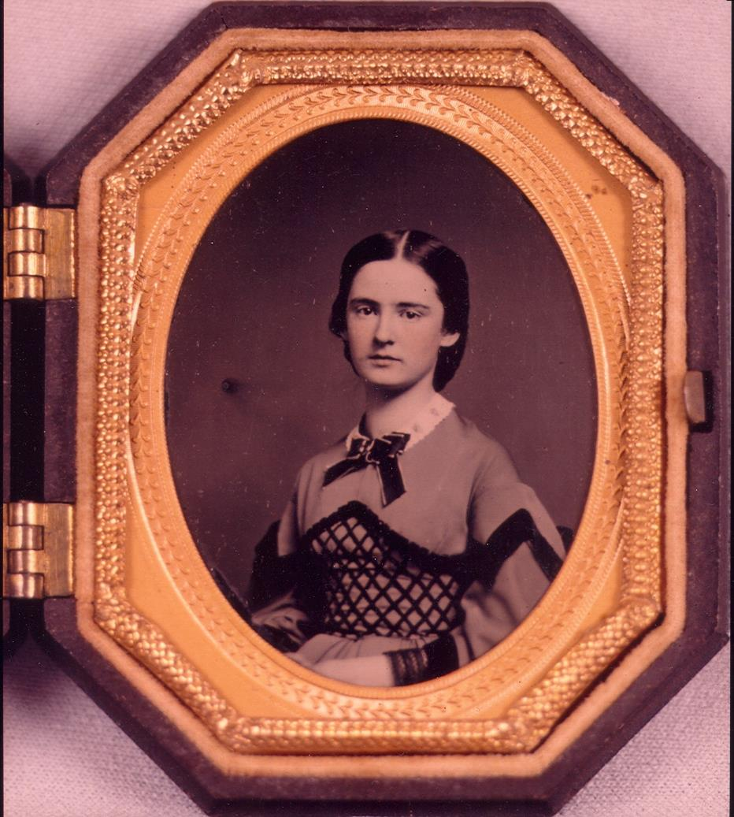

Slide 19
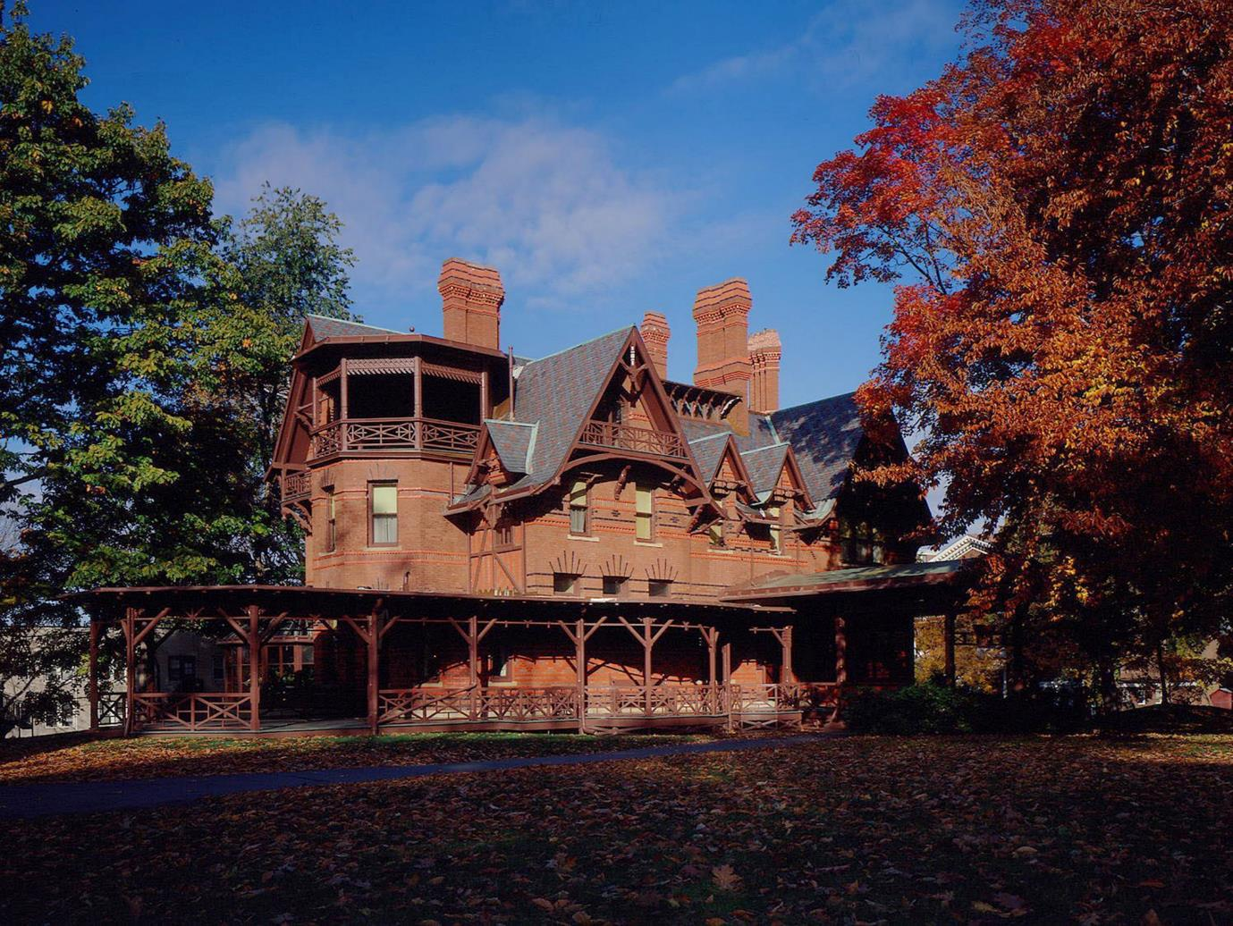

Slide 20
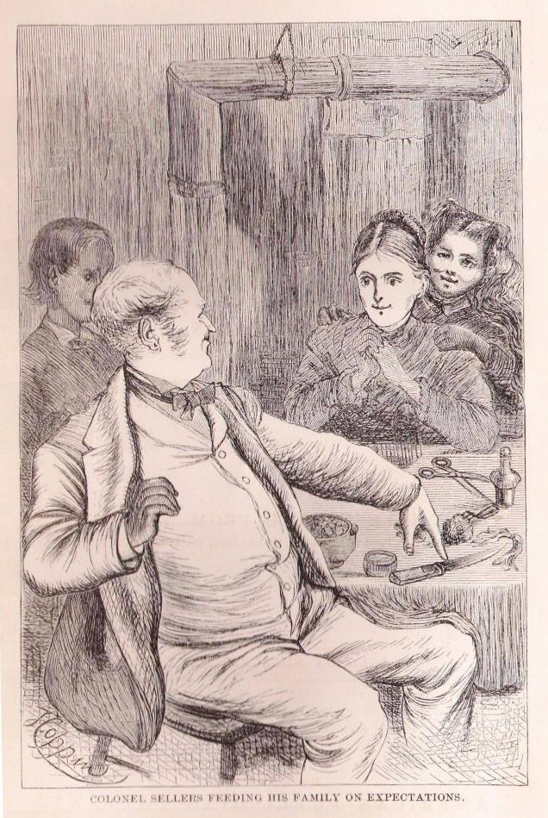
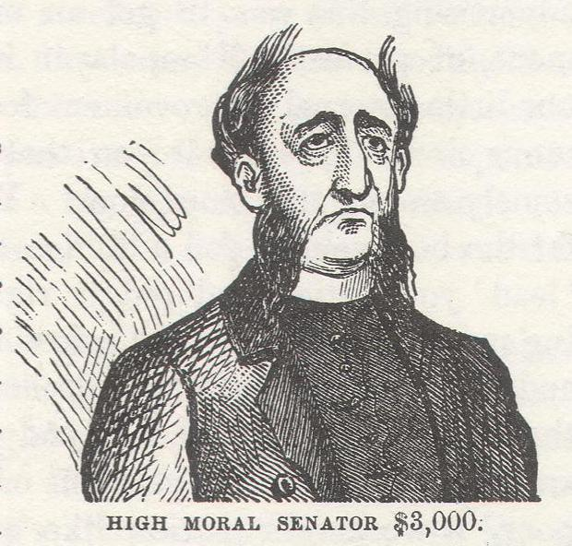

Slide 21
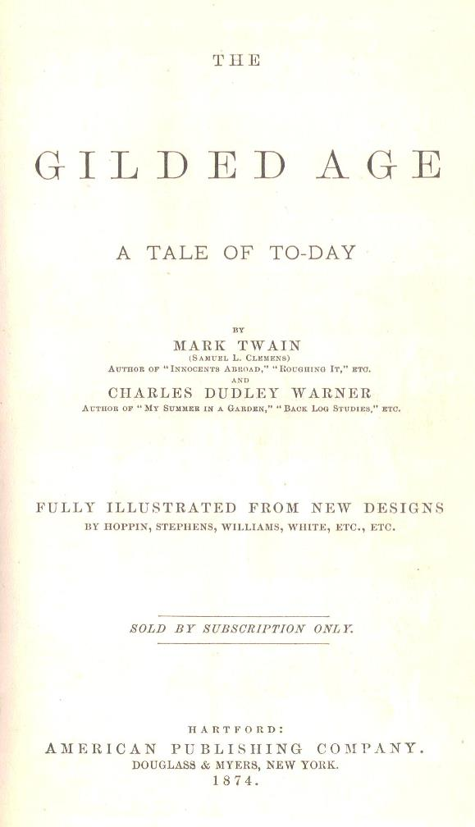

Slide 22
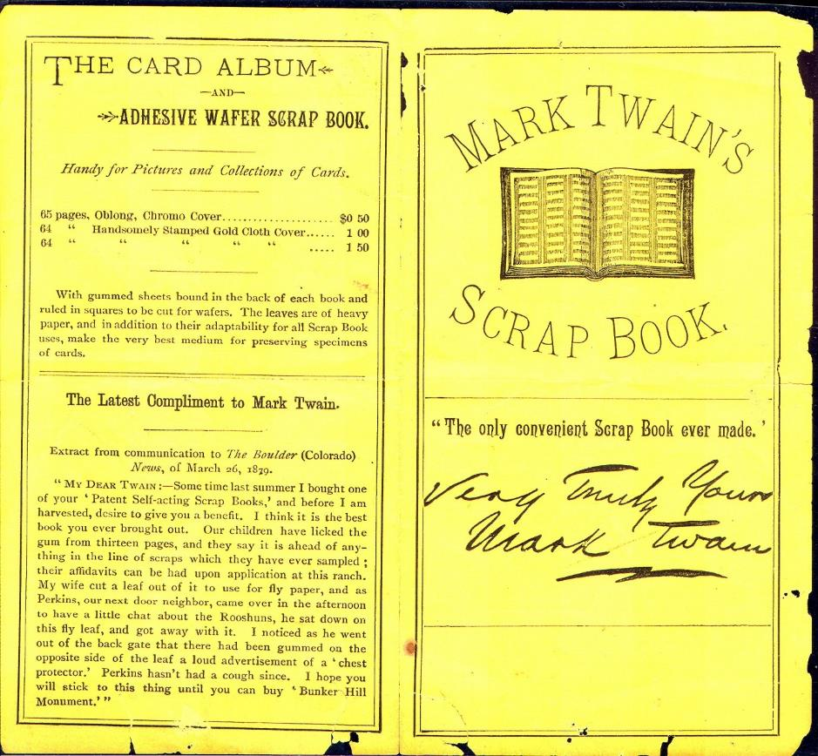
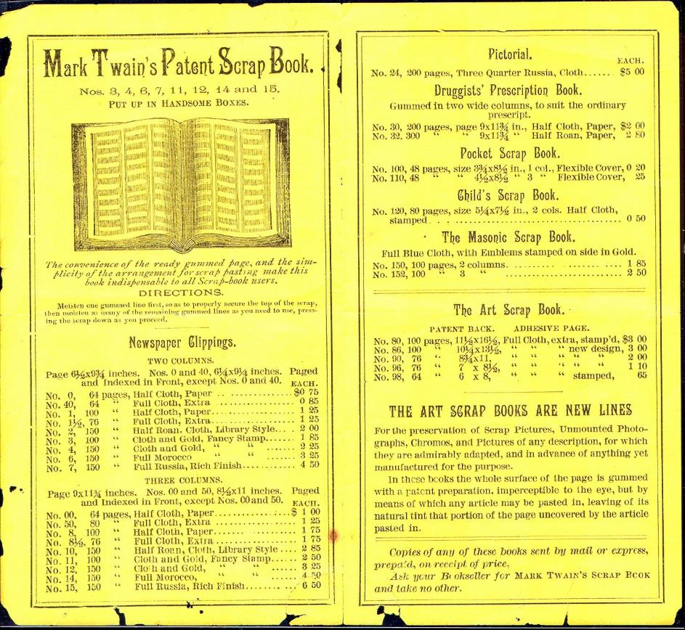

Slide 23
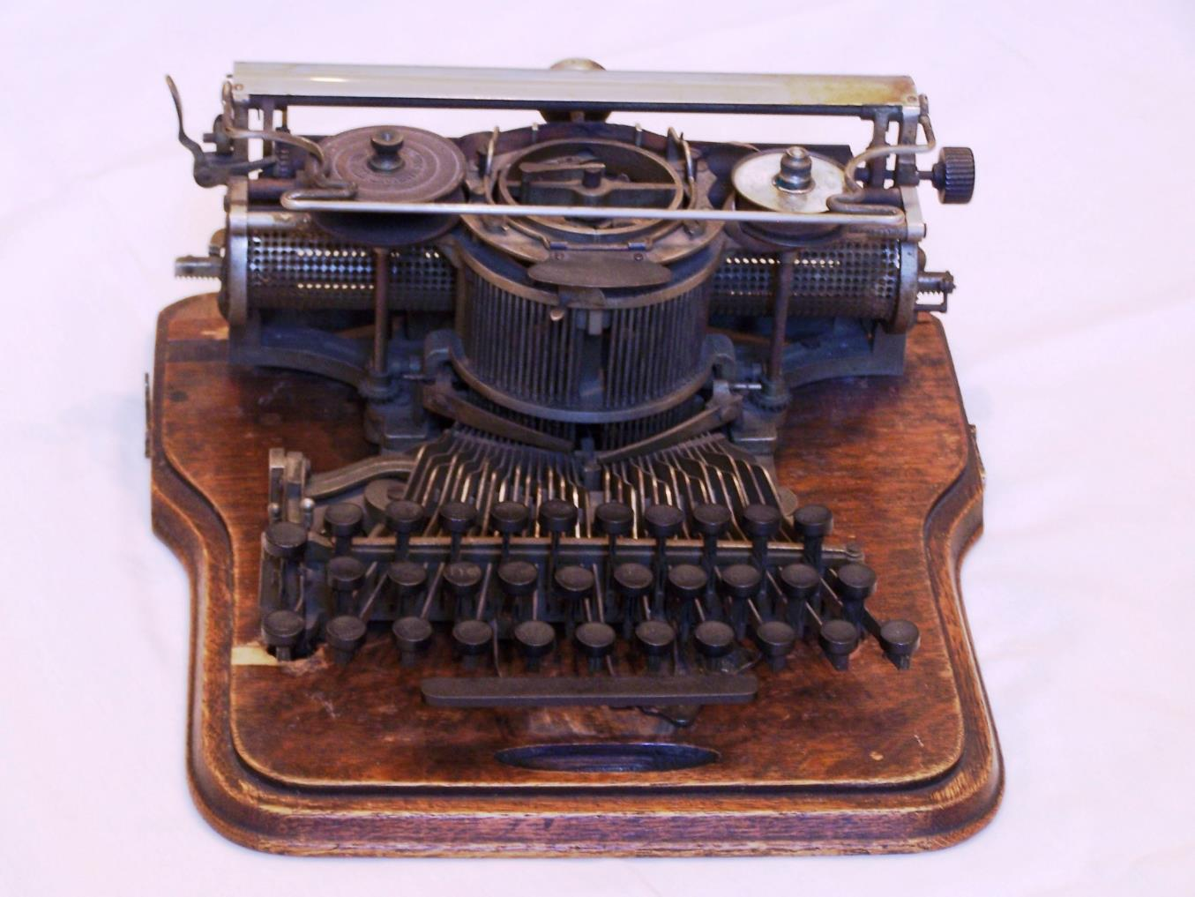

Slide 24
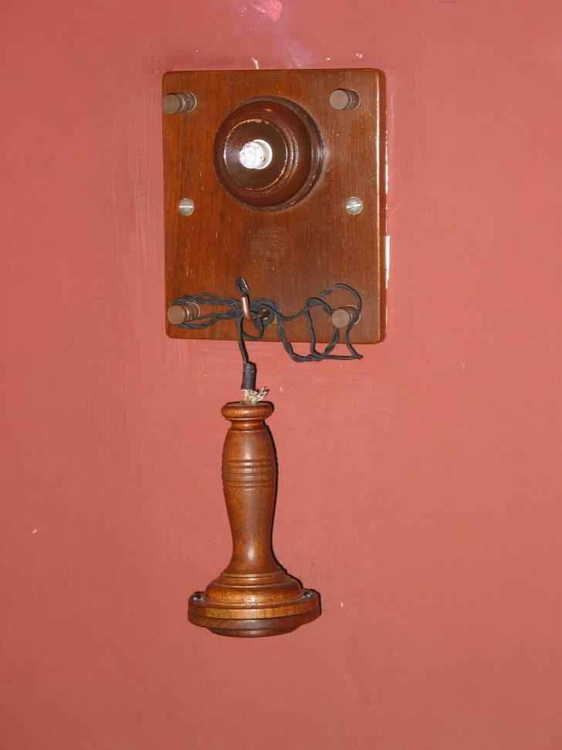
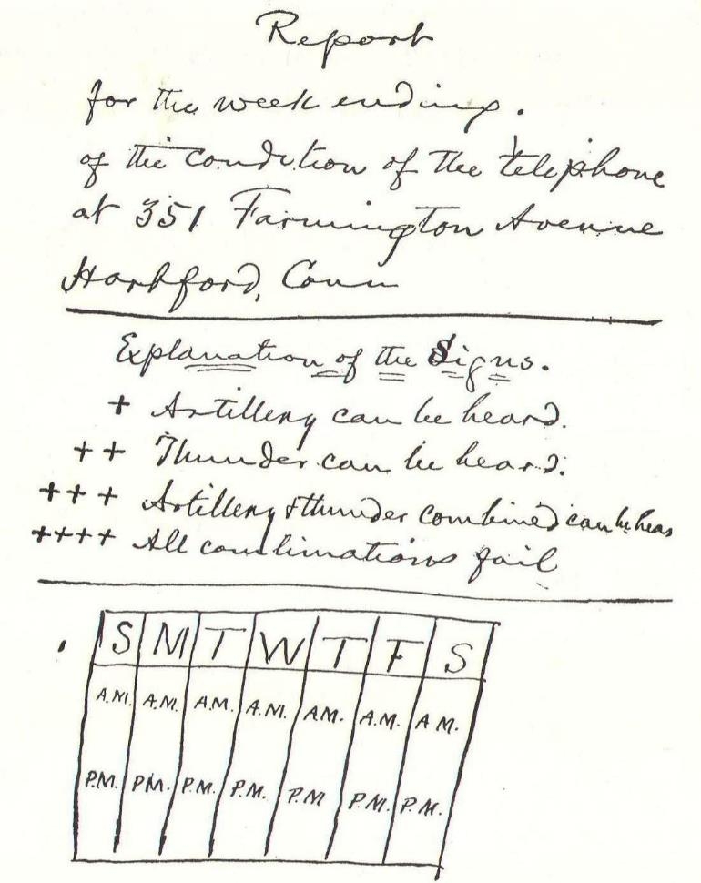

Slide 25
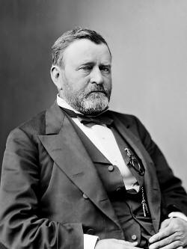

Slide 26
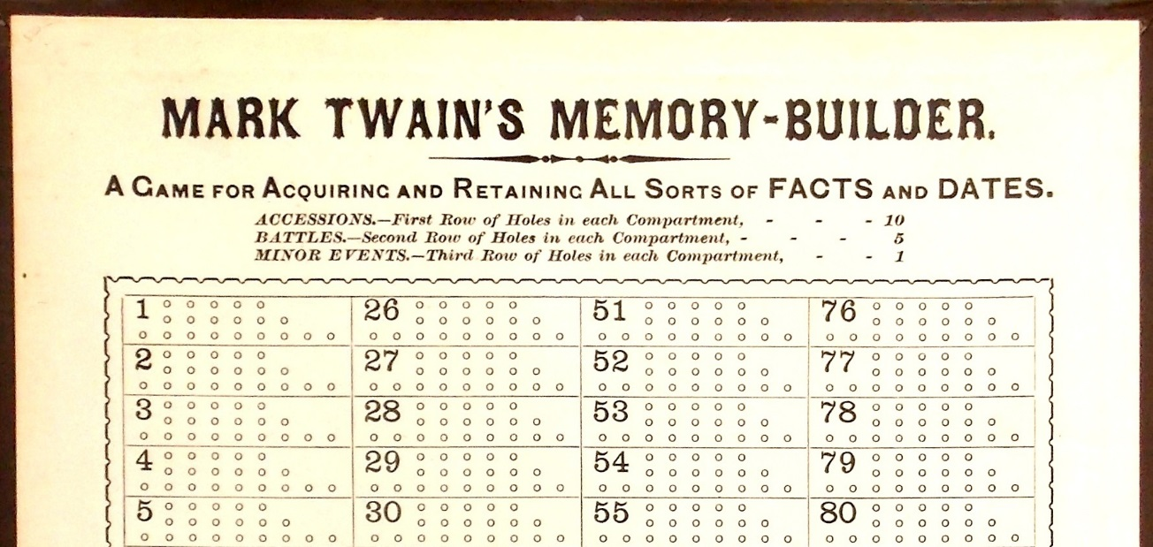

Slide 27
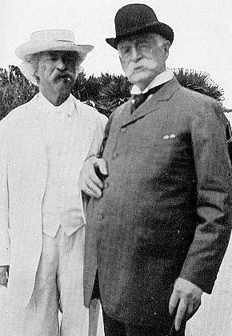

Slide 28
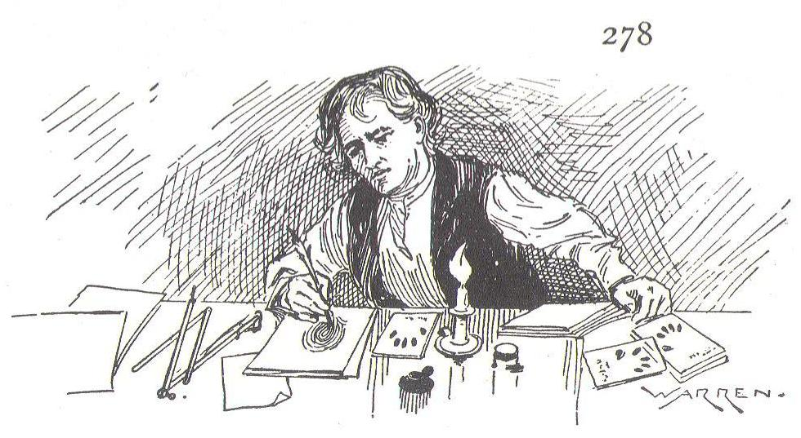

Slide 29
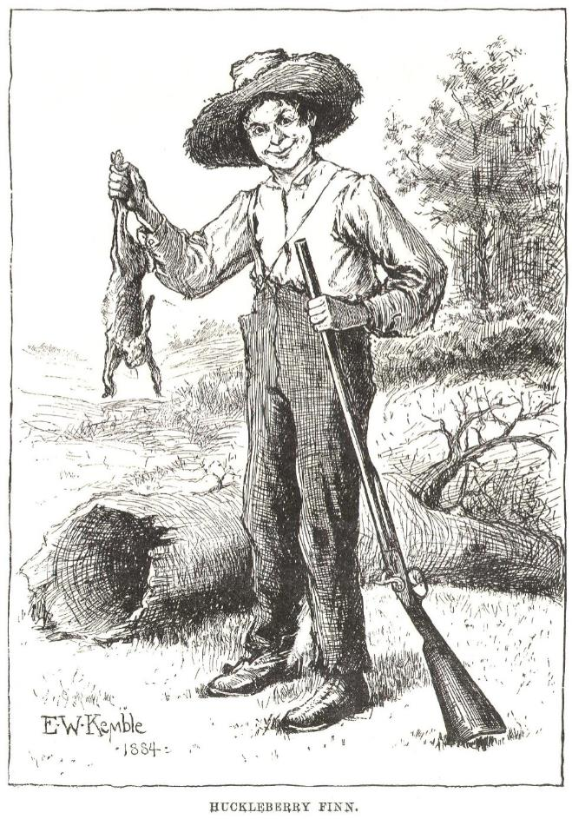
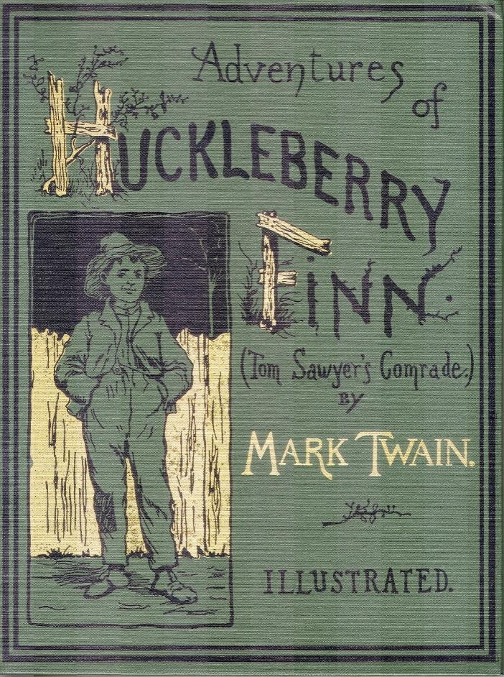
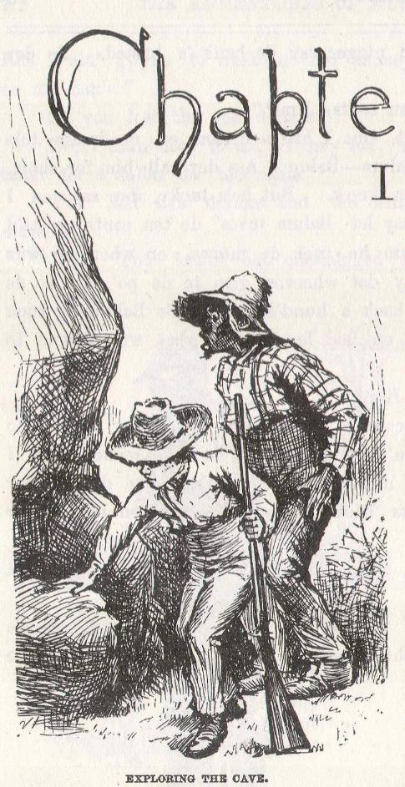

Slide 30
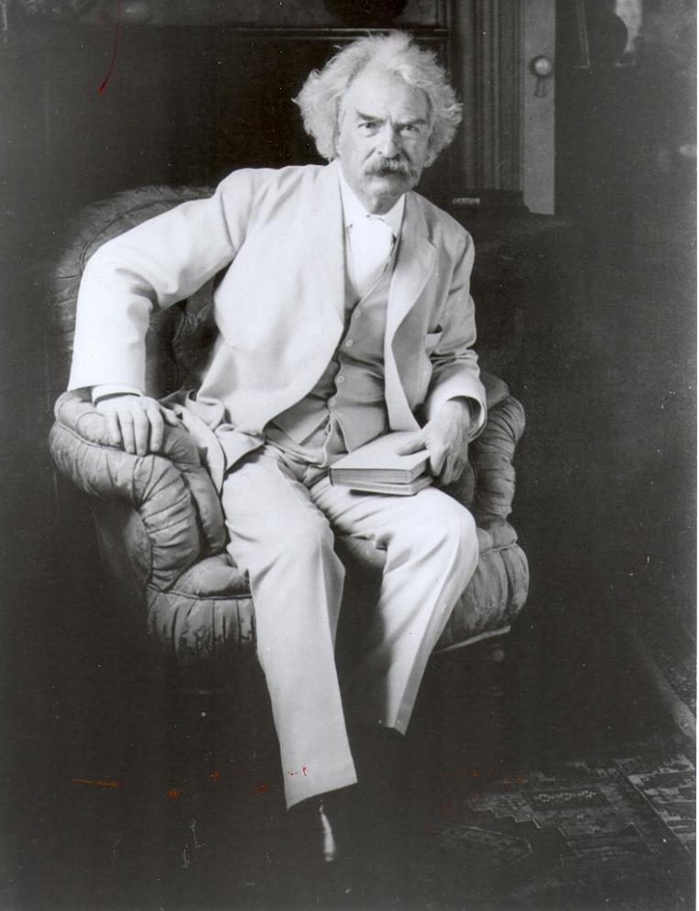
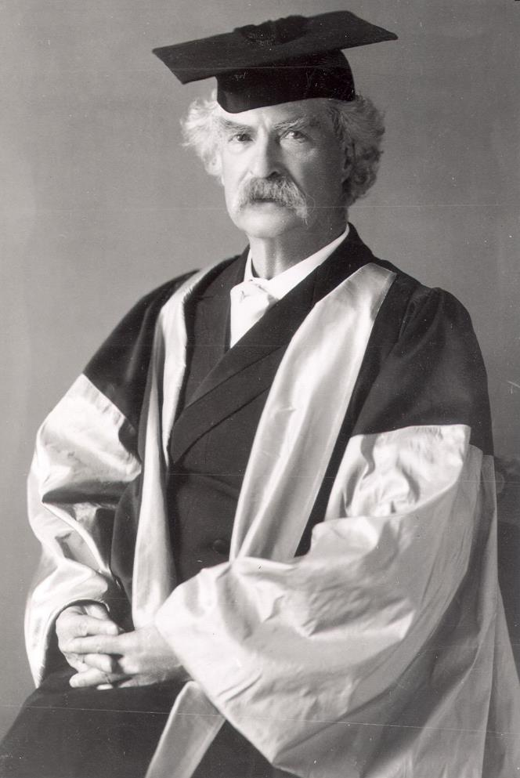

Slide 31
MARK TWAIN
RIGHT PLACE RIGHT TIME
Steamboat Pilot
Nevada – Frontier – Mining
San Francisco – boom times
Hawaii – Hornet disaster
Meeting Charlie Langdon
Subscription Books
Lecturing
The Gilded Age
U S Grant – Memoirs Success
Henry Huttleson Rogers
Adventures of Huckleberry Finn
FIRSTS
Crystal Palace – World’s Fair
Cruise Trip to Europe
Scrapbook Patent
Typewritten Manuscript
Telephone
Memory Builder Game

