Slide 1
Race, Content, and Teaching for Liberation
Dr. Shante’ Lyons and Dr. Rob Good
Ladue Horton Watkins High School

Slide 2
Two Stories from the Classroom
Rob’s Story
Shante’s Story

Slide 3
What are your stories?
In Pairs
In Large Group

Slide 4
What is Liberation for your learners (And Self)?
The same educational process which inspires and stimulates the oppressor with the thought that he is everything and has accomplished everything worth while, depresses and crushes at the same time the spark of genius in the Negro by making him feel that his race does not amount to much and never will measure up to the standards of other peoples. -Carter G. Woodson, The Mis-Education of the Negro, 1933

Slide 5
Confessions from an Imperfect Ally
Starting with self and recognizing the link between identity and curricular understanding.
Interpersonal work, with students and faculty. Culturally responsive pedagogy (Gloria Ladson-Billings & Geneva Gay)
Systematic work, always with an eye towards self.
Systematic
Interpersonal
Self

Slide 6
Reflections of a Black teacher teaching for liberation
Cultural Capital, Content Expertise, and a “humane” and “critical” pedagogy are essential to the holistic development of all students.
Storytelling and Counter Storytelling: Speaking truth to Power and “combating the the notion that cultural/racial experiences are universal in nature” (Chandler, et al ,2015)
The classroom as a “geography of resistance” to dominant/exclusive ideology.

Slide 7
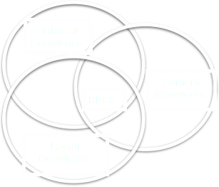
Racial Pedagogical Content Knowledge in the Classroom
Recognizes that the history of race and racism is essential to understand United States history.
Requires teacher self-reflection about the influence of race and identity on their personal, pedagogical and curricular choices
Develops curriculum and pedagogy to help ALL students gain a deeper understanding of the role of race in United States and World History

Slide 8
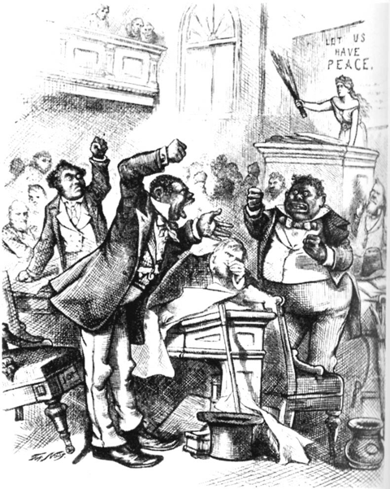
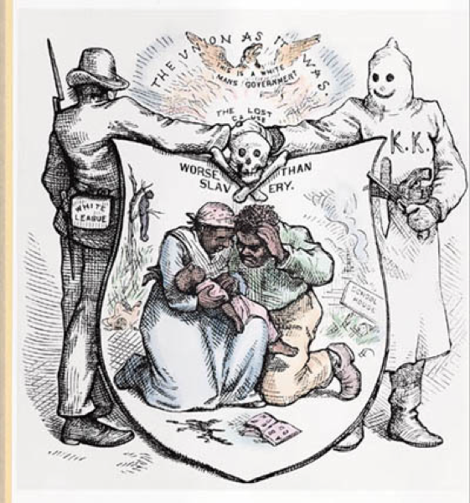
RPCK and Reconstruction
Two Thomas Nast cartoons from 1872, published in Harper’s Weekly..

Slide 9
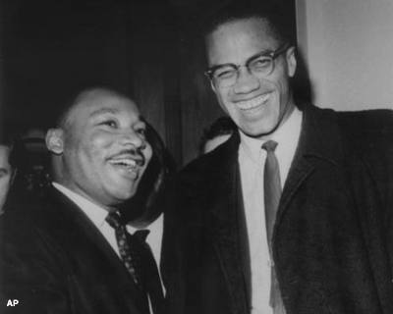
RPCK and Civil Rights Narratives

Slide 10
Contact Us
slyons@ladueschools.net
rgood@ladueschools.net

